Slide 1
Topics
What is convolution?
How do we use NLP for deep learning?
What is a RNN?
EXAMPLES
Predicting 1001 dog breeds
Predicting the Amazon Review Score based on Text
Predicting Cases of Diseases

Slide 2
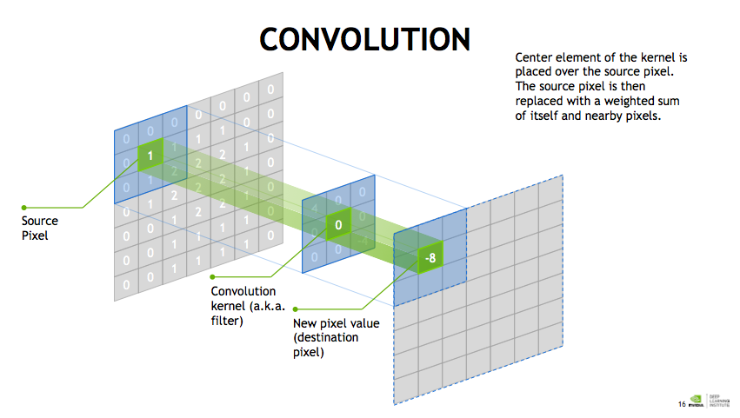
Notes:
Draw a convolutional neural network – used for image classification, image detection and localization, and image segmentation. The key component of how these CNNs operate is through convolution.

Slide 4
NLP for Sentiment Analysis

Slide 5
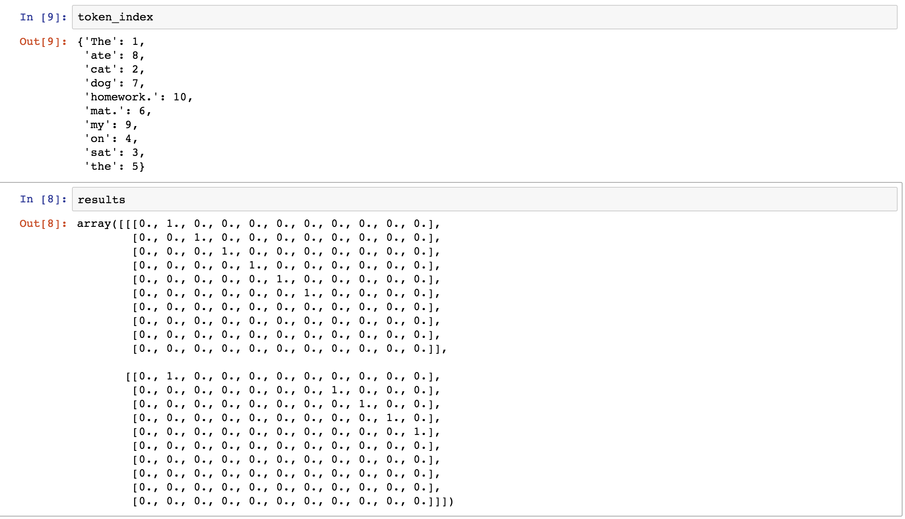
max length = 10
so, each array is 10 chars long
the
'The cat sat on the mat.'
cat
mat
no mentions of ‘ate’, ‘dog’, ‘homework’, ‘my’
'The dog ate my homework.'
no mentions of ‘’cat’, ‘sat’, ‘on’, ‘mat’, ‘the’
(we should lower-case all so that there is no difference between ‘The’ and ‘the’

Slide 6
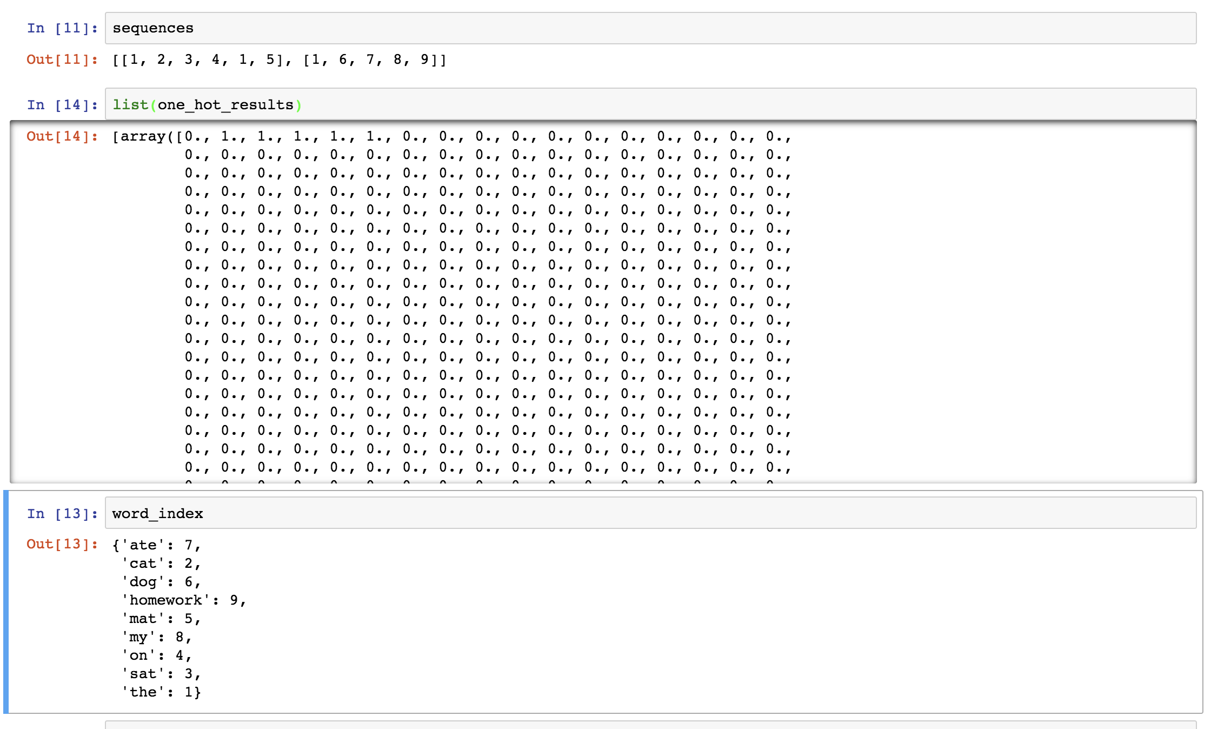
'The cat sat on the mat.'
'The dog ate my homework.'
consider a dictionary of 1000 terms!

Slide 7
image from https://freecontent.manning.com/deep-learning-for-text/
pre-trained word embedding is like a pre-trained convolutional net
greater the vocabulary, the higher the dimensionality

Slide 8
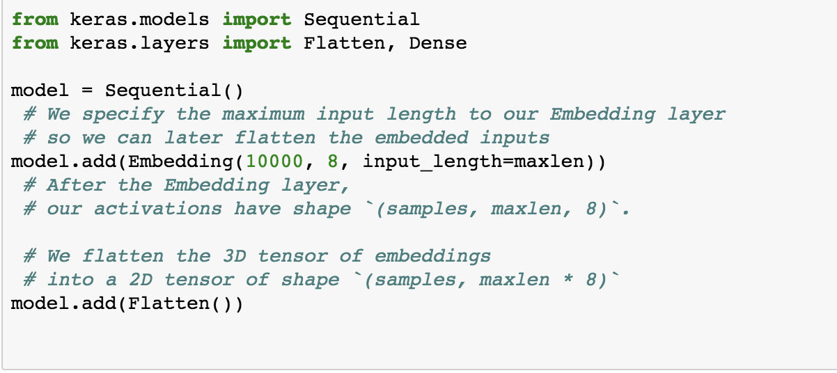
First we create a word_index
This is a 2d array: (number_samples, sequence_length)
here is it (4, 10)
Converted to Embedding Layer (which is like a dictionary lookup) of 3D array: (samples, sequence_length, dimensions_of_embeddings)
max length = 10
1 | 2 | 3 | 4 | 1 | 5
1 | 6 | 7 | 8 | 9
1 | 2 | 3 | 4 | 8 | 6 | 5
1 | 6 | 7 | 1 | 5
'The cat sat on the mat.'
‘The dog at my homework.'
'The cat sat on my dog mat.'
'The dog ate the mat.'
{'ate': 7,
'cat': 2,
'dog': 6,
'homework': 9,
'mat': 5,
'my': 8,
'on': 4,
'sat': 3,
'the': 1}

Slide 9
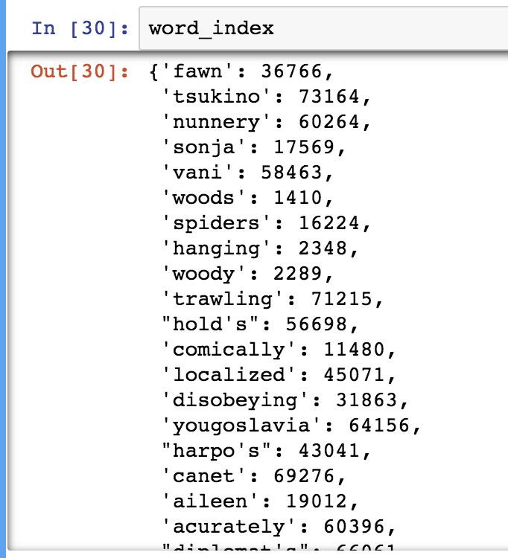
You always need to specify:
#this means the maximum number of words for any sequence (sentence)
max_length, e.g. 100
#this means the maximum number of words (most common words) to be used to create the dictionary
max_words e.g. 10000
embedding_dim = 100
"This film lacked something I couldn't put my finger on at first: charisma on the part of the leading actress. This inevitably translated to lack of chemistry when she shared the screen with her leading man. Even the romantic scenes came across as being merely the actors at play. It could very well have been the director who miscalculated what he needed from the actors. I just don't know.<br /><br />But could it have been the screenplay? Just exactly who was the chef in love with? He seemed more enamored of his culinary skills and restaurant, and ultimately of himself and his youthful exploits, than of anybody or anything else. He never convinced me he was in love with the princess.<br /><br />I was disappointed in this movie. But, don't forget it was nominated for an Oscar, so judge for yourself.",
tokenize
word_index
load pretrained word embedding: gloVe
build embedding matrix of shape (max_words, embedding_dim)

Slide 10
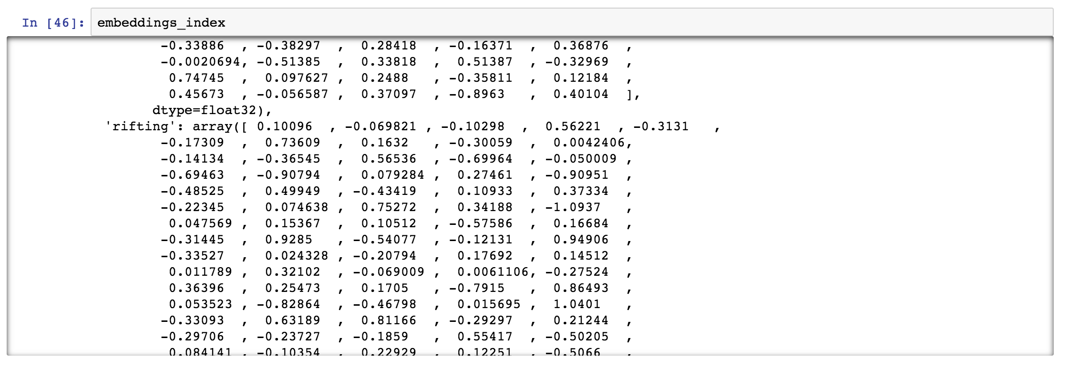
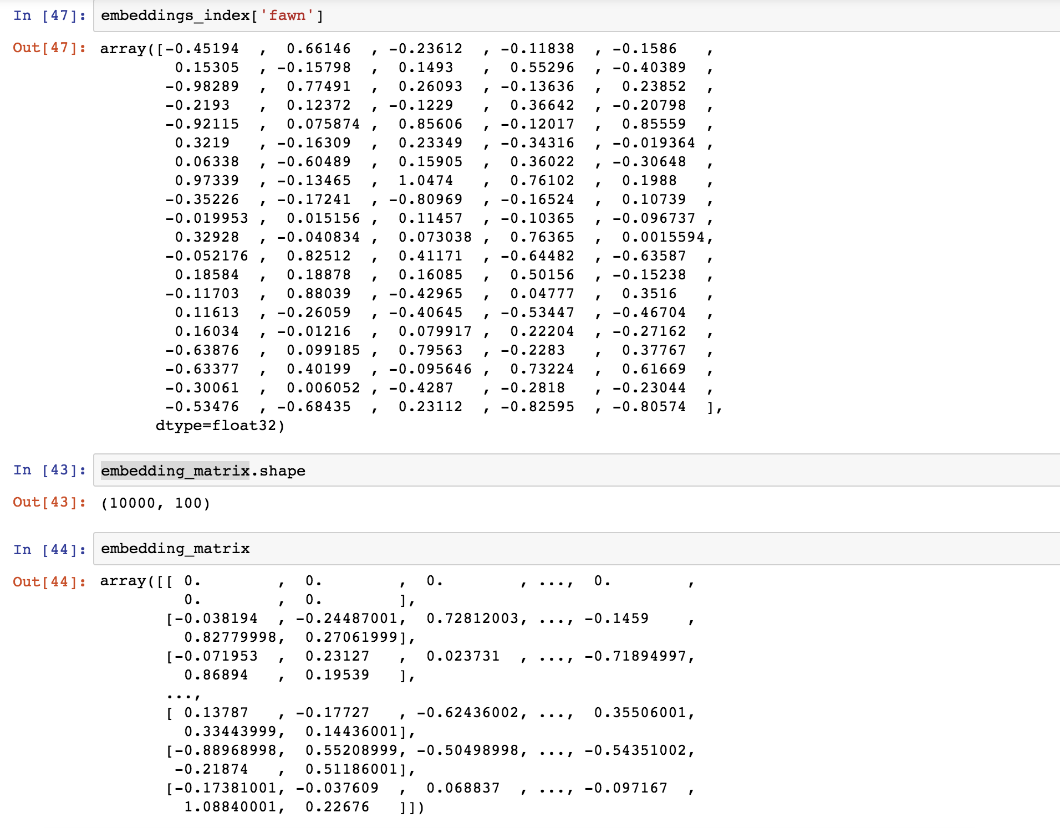
You tokenized and created a word_index that assigned an integer to each unique word in the IMDB corpus
Then you loaded in the GloVe pre-trained word embedding that was collected by crawling Wikipedia, from Stanford. Each word has an associated vector of words it has been commonly found to be associated with.
I took a guess and looked up the word ‘fawn’ from the GlOVE index
You then run a script that will LOOK-UP each of the unique words in the `word_index` and add that specific word’s vector from the embeddings_index into the embedding_matrix, which we specified will have a dimensionality of 1000:
embedding_matrix = np.zeros((max_words, embedding_dim))
each index in this array has the same type of vector like what’s shown for ‘fawn’ for each words in the embeddings_index

Slide 11
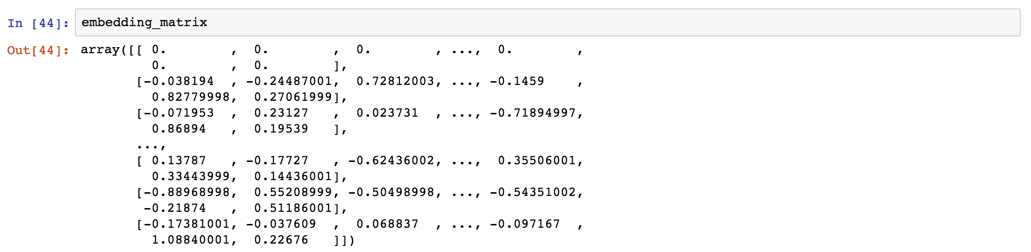
model.add(Embedding(max_words, embedding_dim, input_length=maxlen))
model.layers[0].set_weights([embedding_matrix])
model.layers[0].trainable = False #<- this is frozen

Slide 12
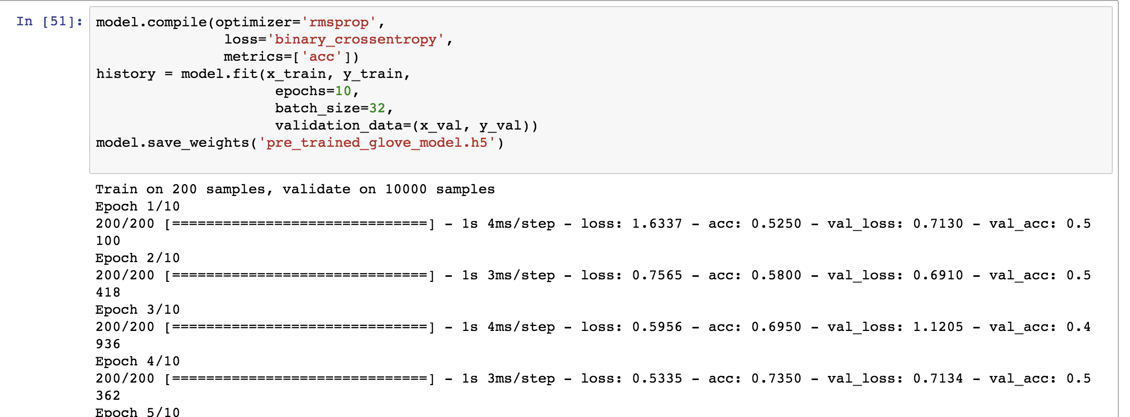
0.57604 accuracy on test set ☹

Slide 16
